Slide 1
Save Money!
Get Fit!
Cash In!
A Systems Approach To Wellness
A Breakthrough in Consumer Understanding

Slide 2
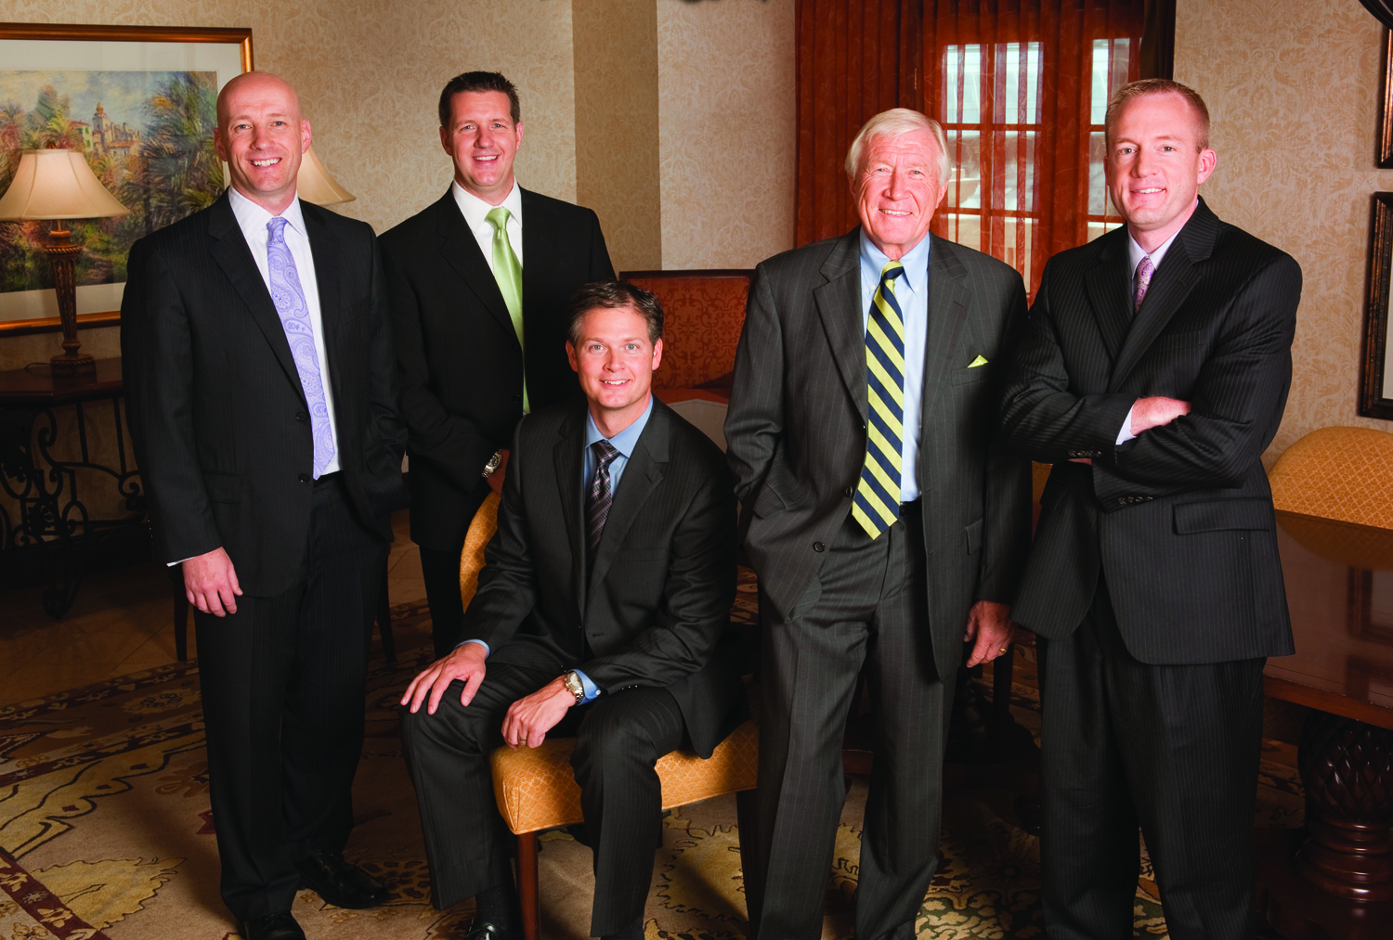
The Best Indicator of Future Success Is Past Performance!
Key positions in $100 million to $23 billion companies
Notes:
2

Slide 3
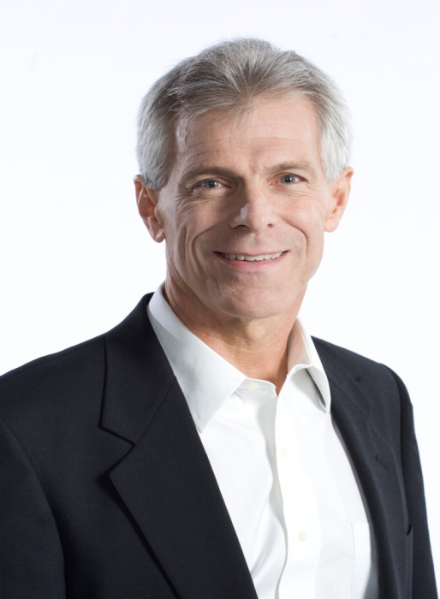
Scientific Advisory Board`
Doctor Developed, not “Endorsed”
Dr. Marcus Laux
Dr. Donald K. Layman
Chairman, Scientific Advisory Board
World-renown Naturopathic Physician
2009 won Nutritional and Metabolism National Leadership Award
Published 90 Peer Reviewed Publications
Notes:
Because world-class scientifically validated products are at the heart of the Qivana opportunity, the q management team sought to create a world-class advisory team to assure our place as a leader and innovator in the natural products world.
Our adisory Board headed by Dr Marcus Laux brings decades of education and peer reviewed research to Qivana.
If you take the time to research any or all of the gentlemen on this slide it will be obvious that Qivana intends to be the gold standard in the creation and marketing of life changing natural products by associating itself with the most respected scientists in the field of natural products.
3

Slide 4
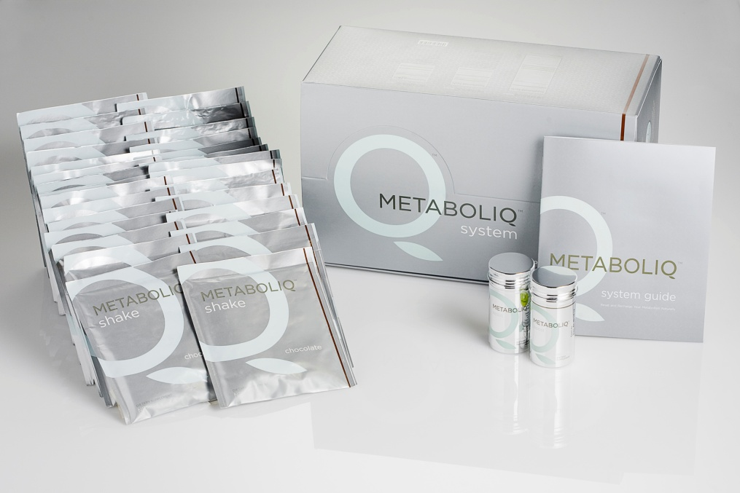
Qivana’s Revolutionary Strategy!
Weight Management
system
Notes:
Qivana's revolutionary Systems approach to wellness separates Qivana from the "me toos" of the natural product world.
This simple, synergistic SYSTEMS approach to enhanced health creates a framework for a variety of systems to be introduced into the Q product line over time.
Our first System is called the Qore System...scientifically designed and validated to stabilize, vitalize and optimize your state of health.
4

Slide 5
QORE™ PROBIOTIC
Patented acid resistant shell
Replenishes healthy bacteria to intestine. (80/20)
Assists in healthy digestion and nutrient absorption
Enhance your immune defense system
Notes:
5

Slide 6
THE IMMORTALITY HERB!
ESSENTIALS
Alter the way you experience the aging process
Supports healthy cardiovascular system
Assists in stabilizing blood sugar levels
QoreTM Essentials Ingredients
White Korean Ginseng
Skull Cap
The Immortality Herb (Gynostemma Pentaphylum)
Notes:
6

Slide 7
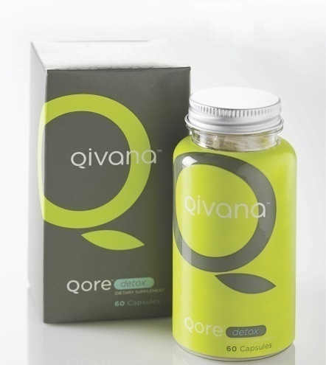
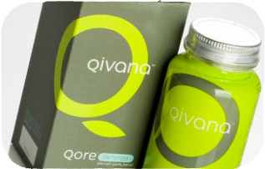
Free Every Third Month!
QORE™ DETOX
Detoxifies the body from heavy metals, radioactive elements and free radicals
Binds toxins to prevent re-absorption
OR…
QORE™ DEFENSE
Blend of 6 medicinal mushrooms
Supports healthy immune function
Protects against chronic infection
Notes:
7

Slide 8
system
Backed by 30 years of research and over 100 published scientific studies
Nearly 75% of the US Population is Overweight.
Notes:
8

Slide 9
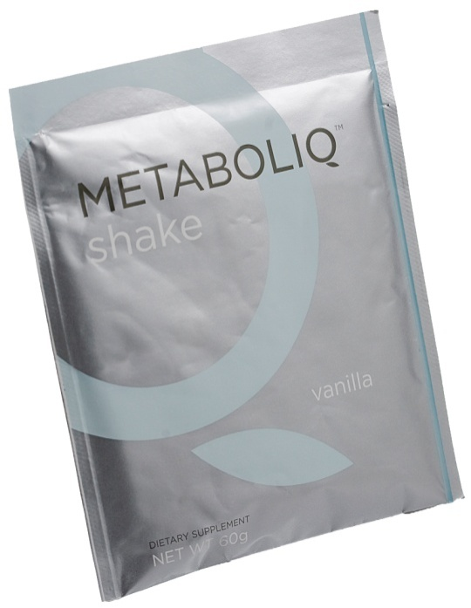
system
METABOLIQ™ SHAKE
Burns Fat For 4 Hours While Building Muscle
Complete Meal Replacement
Save Money, Eat Healthier!
METABOLIQ™ BAR
Between-Meal Snack Perfectly Balanced
Oven Cooked For Incredible Taste
Notes:
9

Slide 10
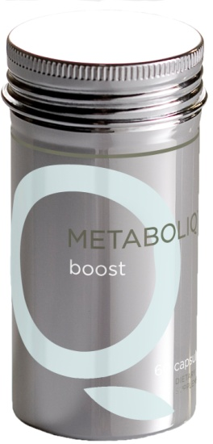
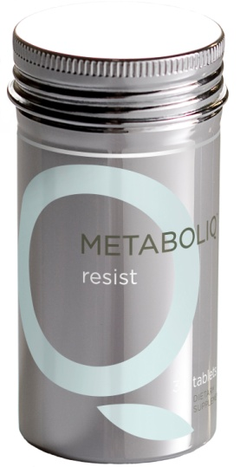
system
METABOLIQ™ BOOST
Patented formula that can increase metabolic rate up to 25% for 4 hours
Burns Calories And Accelerates Fat Loss
Studies show Test Subjects Lost 3 Times The Weight Using Boost Over A Placebo
METABOLIQ™ RESIST
Temporarily blocks sugar receptors
Repress sweet cravings for up to 2 hours
“Willpower in a Can!”
Notes:
10

Slide 11
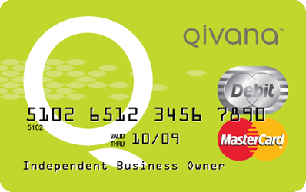
Home Based Business “The Opportunity”
Retail Profit
$80 retail - $65 wholesale = $15 profit
Tax Advantages!
Commissions are paid on the difference between your customers’ purchase price (retail) and your wholesale price.
Qualify For Residual Income
“Go Silver”
Sponsor one Left You Qualify for Income! Sponsor one Right
Notes:
11

Slide 12
Team Commissions-The Binary
Lesser Leg
10% Commission paid weekly on lesser leg
Every 100 persons x 100 pv = $1,000 !
Larger Leg

Slide 13
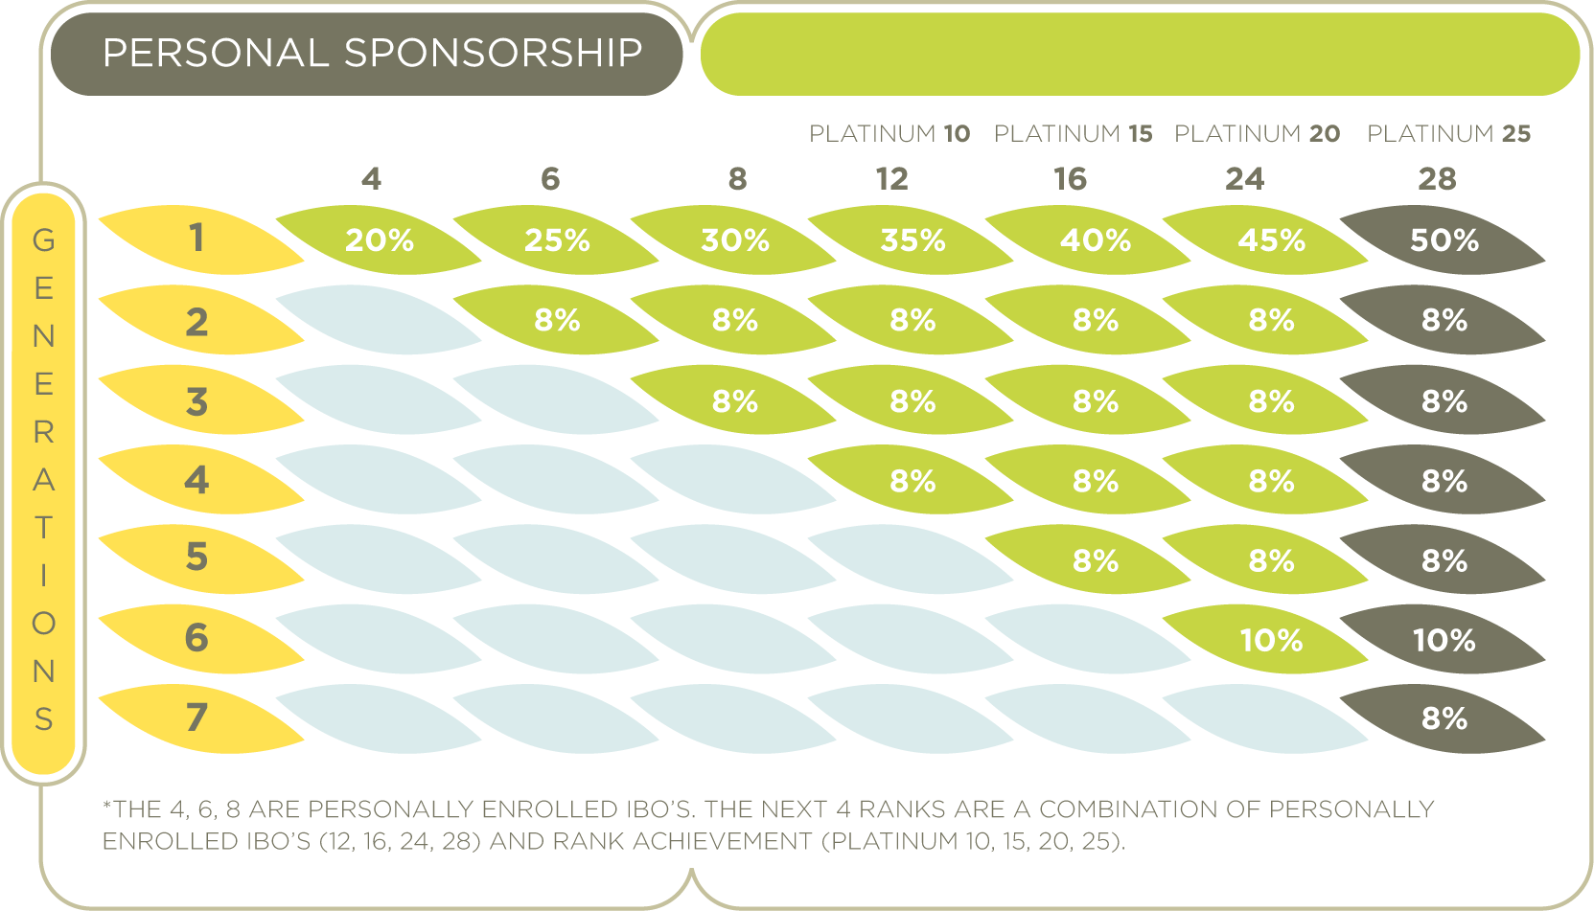
Executive Matching Bonus
EMB is a variable pool measured week to week
Your match is dependent on the check that your people are making in the Binary Comp Plan
A “Generation” is not the same thing as a level
Four things you must do to get into this part of the comp plan:
One time $250 order
Be on at least 100 PV autoship
Sponsor one on your left and one on your right
Sponsor at least 4 persons

Slide 14
Earning Potential Per Rank
Silver $500 per week
Silver Star $750 per week
Silver Pro $1,000 per week
Gold $1,250 per week
Gold Star $1,500 per week
Gold Pro $1,750 per week
Platinum $2,000 per week
Platinum Star $2,250 per week
Platinum Pro $2,500 per week
Diamond $2,750 per week
Executive Diamond $3,000 per week
Presidential Diamond $5,000 per week
Royal Diamond $7,500 per week
Crown Diamond $10,000 per week

Slide 15
Qivana Drive Rewards
Achievement has its rewards…

Slide 16
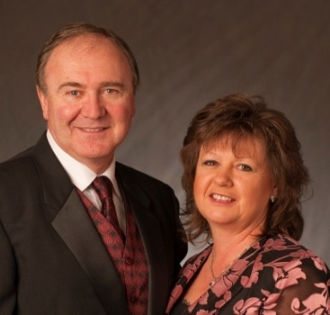
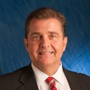
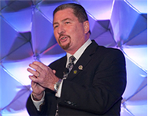
Your Support Team
Executive Diamonds
Frank and Paige Zecher
Diamonds
Tony and Debbie Underwood
Diamonds
Bill and Laura Wolfington
Presidential Diamonds
Vernon and Debra Douglas
Diamond
Steph Carse
Master IBO
Joe Land
Master IBO Marshall Douglas
Master IBO
John Terhune

Slide 17
What’s your next step?
1
Enroll as an IBO $45.00
2
Place initial order
$250, $500 or $1,000
3
Create a Monthly Autoship

Slide 18
Over a Million Dollars in Trips Earned This Year!
Atlantis
Hawaii

Slide 19
Save Money!
Get Fit!
Cash In!
A Systems Approach To Wellness
A Breakthrough in Consumer Understanding

